Slide 1
Large Parts Inventory Sheets
NXT

Slide 2
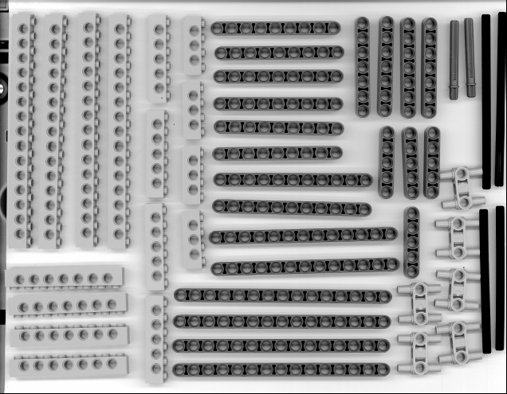
Inventory Sheet #1

Slide 3
Inventory Sheet #1
ONLY NEED 2 of these

Slide 4
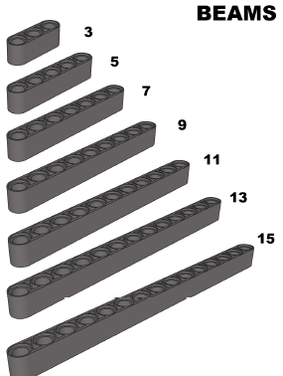
BEAMS

Slide 5
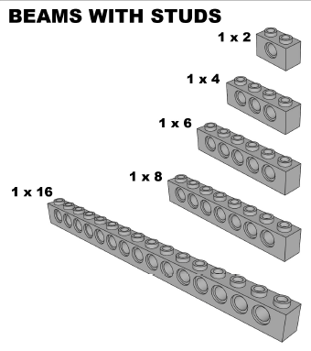
STUDDED BEAMS

Slide 6
BEAM JOINERS (only need 2)

Slide 7
AXLE WITH STOP

Slide 8
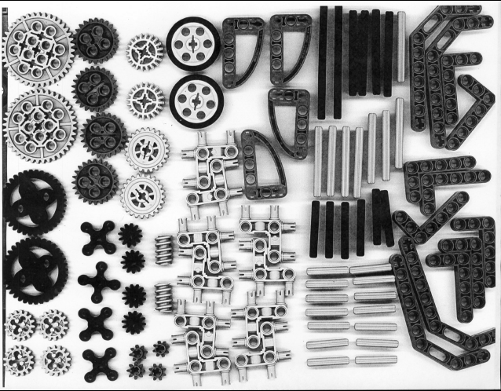
Inventory Sheet #2

Slide 9
Inventory Sheet #2
NEED 4
ONLY NEED 6

Slide 10
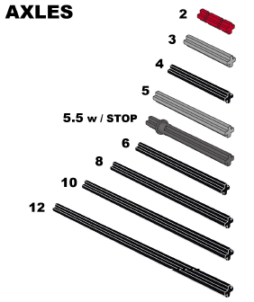
AXLES
*10, 12, and 5.5 w/ Stop on Sheet #1

Slide 11
LIFT ARMS
*2 x 4 and 4 x 6 on Sheet #3

Slide 12
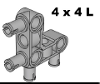
L-SHAPED BEAM JOINERS (only need 6)

Slide 13
WHEELS (need 4)

Slide 14
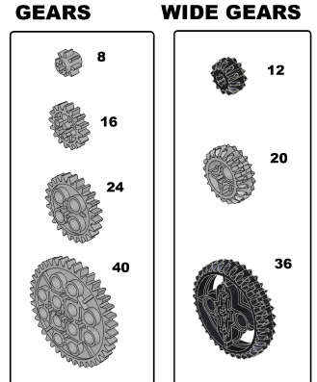
GEARS

Slide 15
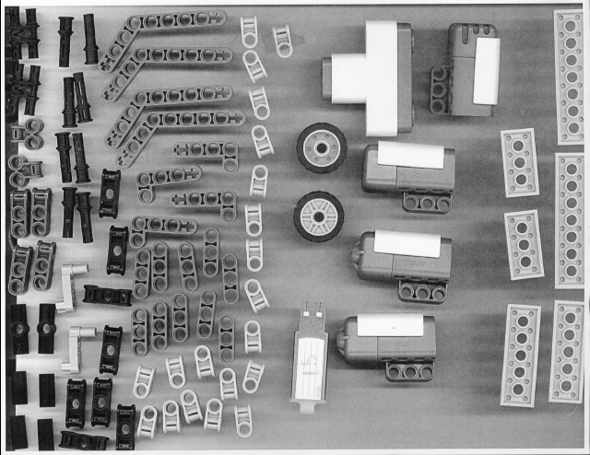
Inventory Sheet #3

Slide 16
Inventory Sheet #3
X

Slide 17
SENSORS

Slide 18
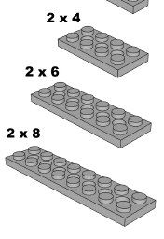
PLATES

Slide 19
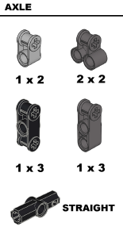
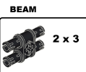
JOINERS

Slide 20
LIFT ARMS

Slide 21
WHEELS

Slide 22
BEAMS

Slide 23
PEGS

Slide 24
CRANKS

